Slide 1
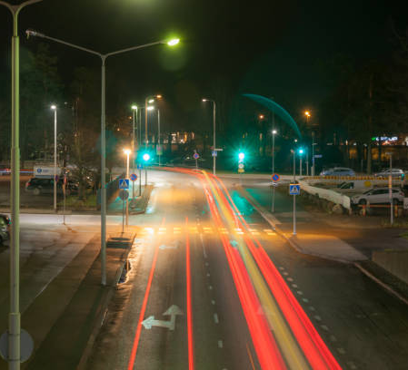
Automatic Traffic Monitor
Adit Sinha, Arhaan Garg
Step by Step school

Slide 2
Contents
Slide no. | Content
3 | Introduction
4 | Overview
5 | Project Details
6,7 | Features of the System
8 | Plan of Implementation
9 | Bibliography

Slide 3
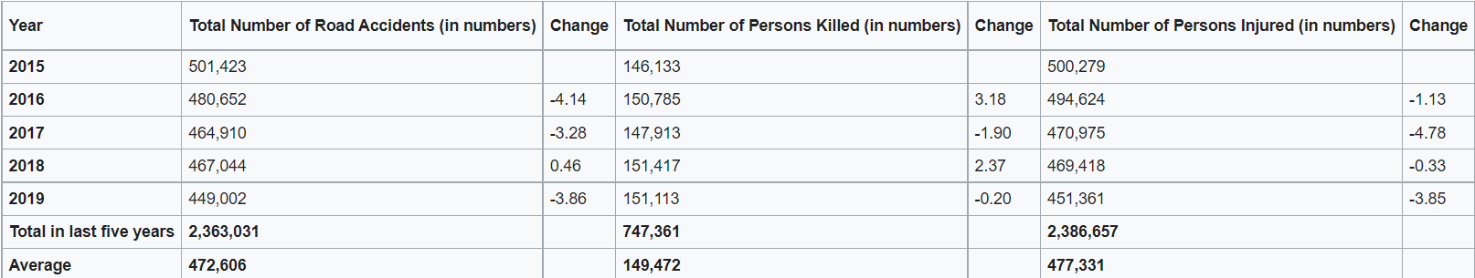
Introduction
Several major problems such as lack of health maintenance, impact of burning non-biodegradable substances, etc. are often overlooked in India. One of these problems is Road Safety.
Having the fourth largest automotive industry in the world, Indian roads are often very busy and filled with traffic. Basic traffic regulations such as lanes, red lights, etc. are often disregarded by both urban and rural drivers. These factors resulted in an astonishing 151,000 (approx.) deaths in 2018 and 2019 due to car accidents. Due to the busy roads, it is also difficult for hospitals, fire brigades, etc. to swiftly provide help to those in need.

Slide 4
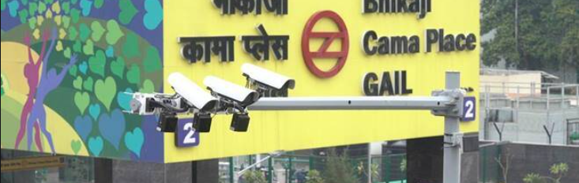
Overview
A major reason for these deaths is the massive driver to traffic officer ratio. There is a very small amount of people who enforce traffic rules as compared to drivers. As a result, we have designed a prototype for an Artificial Intelligence operated traffic monitor to help enforce traffic rules.
While some states such as Uttar Pradesh, Delhi, etc. have started installing CCTV cameras and speed detectors, they do not use sensors and transmitters as used by countries such as Japan, Hong Kong, etc.
Our prototype uses Arduino Ultrasonic sensors, Colour sensors, Impact sensors, GSM, buzzer, LED lights, etc. to implement features such as automatic accident prevention, automatic accident detection, etc. which would help in preventing car accidents and monitoring drivers.

Slide 5
Project Details
Our project proposes a quite efficient way to control traffic.
Our project is based on preventing road accidents. Our prototype detects whether cars on a road may collide or not. The ultrasonic sensors which will be fit on either side of the road, using IoT will communicate. If they have a chance of colliding it will inform the drivers of the cars using GSM.
Then if due to some reasons collision occurs, the next step is detection. For this purpose, a smartphone-based accident detection and notification system will track the accident with the help of deployed impact sensors and will process the data through a micro-controller unit and then with a Smartphone app GPS. The GSM will send a notification to the nearest emergency services and to the victim's family.

Slide 6
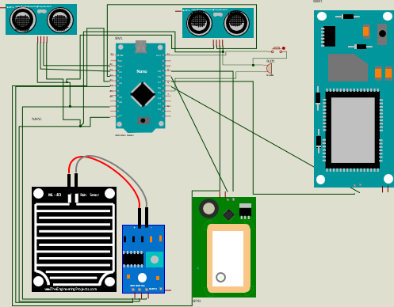
Car Proximity Detectors
To prevent accidents, ultrasonic sensors would be fit on each side of intersection of roads. Fitted a few meters away from the junction, the cars would be alerted with a response time of 0.4 seconds. When these sensors detect that two cars may collide if they keep proceeding, the driver will be alerted through a strong alarm.
This would prevent cars travelling in perpendicular directions from crashing and would resynchronize the flow of traffic therefore making the roads less busy.
The system can also be connected to multiple cars, which could forcefully reduce their acceleration based on the chances of colliding.

Slide 7
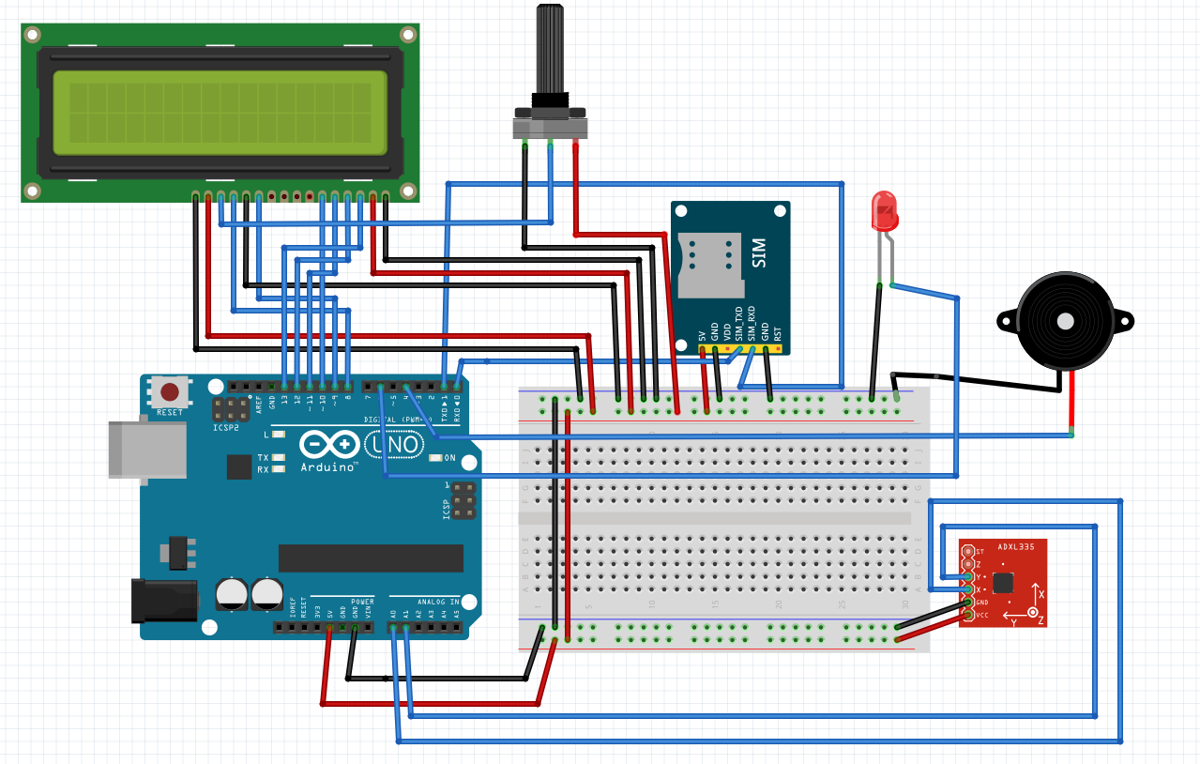
Accident Detection Circuit
Our prototype uses an impact sensor, and an accelerometer which detects the accident which has taken place.
If it detects an accident, it notifies the nearby ambulance, police and victim's family members, providing them with the location coordinates using the GPS module. It notifies them using the GSM Module. The sensing system would be linked to the car's accident sensors which would be used along with the impact sensor and the accelerometer to detect whether an accident has taken place.

Slide 8
Plan of implementation
While making this project, our team ensured that the final product is as cost effective as impactful so that it could be distributed across India easily. We also ensured that it can easily be fitted onto any vehicle or road arrangement. Here is a table on the approximate cost of the prototype:
Circuit | Cost of Implementation (INR)
Accident Prevention Circuit (to be fitted on the road) | 710-650
Accident Detection Circuit (to be fitted on the car) | 890-840
Furthermore, the implementation of our project doesn’t require any modifications to be made in the roads system of India making it the most feasible solution for preventing and resolving traffic collisions.

Slide 9
Bibliography
https://www.statista.com/statistics/746887/india-number-of-fatalities-in-road-accidents/
https://www.statista.com/topics/5982/road-accidents-in-india/#:~:text=India%20roughly%20accounts%20for%20just,to%20road%20accidents%20in%20India
https://en.wikipedia.org/wiki/Traffic_collisions_in_India
https://otonomo.io/blog/smart-cities-intelligent-transportation-systems/
https://www.bbc.com/news/magazine-36446652

Slide 10
THANK YOU

